Slide 1
Theory of Automata
بِسْمِ اللهِ الرَّحْمٰنِ الرَّحِيْمِ
Lecture # 05
Imtiaz Ahmed

Slide 2
Equivalent Regular Expressions
Two Regular Expressions are said to be equal if both of them
generates the same language
Example
Consider the following regular expressions
r1 = (a + b)* (aa + bb)
r2 = (a + b)*aa + ( a + b)*bb
then both regular expressions define the language of strings ending in aa or bb.

Slide 3
Definition of Regular Language
The language generated by any regular expression is called a regular language.
If r1, r2 are regular expressions, corresponding to the languages L1 and L2 then the languages generated by
r1+ r2
r1r2 ( or r2r1)
r1* ( or r2* )
are also regular languages.

Slide 4
Definition of Regular Language (Contd..)
If r1 = (aa + bb) and r2 = ( a + b) then
r1+r2 = (aa + bb) + (a + b)
r1r2 = (aa + bb) (a + b)
(r1)* = (aa + bb)*
(r2)* = (a+b)*

Slide 5
Formal Definition Finite Automata
A finite automaton (FA) is a 5-tuple (Q, Σ, q0, A, δ), where
Q is a finite set of states
Σ is a finite input alphabet
q0 ∈ Q is the initial state
A ⊆ Q is the set of accepting states
δ : Q × Σ → Q is the transition function
For any element q of Q and any symbol σ ∈ Σ, we interpret δ(q, σ) as the state to which the FA moves, if it is in state q and receives the input σ .
δ = Lower case Delta
σ = Lower Case Sigma

Slide 6
Finite Automata
Example 1
Construct an FA that ccepts all strings
from the alphabet {a,b} except Λ.

Slide 7
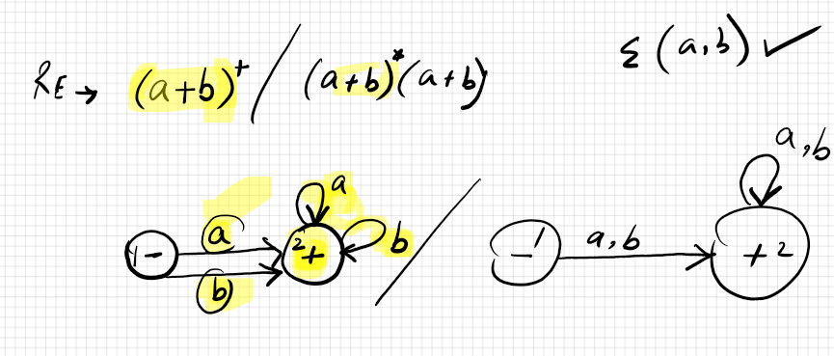
Finite Automata
Solution of Example 1

Slide 8
Finite Automata
Example 2
Construct an FA which accept all words
from the alphabet {a,b} including Λ

Slide 9
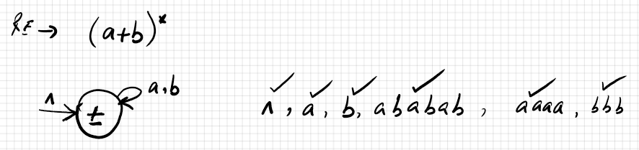
Finite Automata
Solution of Example 2

Slide 10
Finite Automata
Example 3
Construct an FA representing the language
of all words over the alphabet {a, b} that
contain aa as a subword.

Slide 11
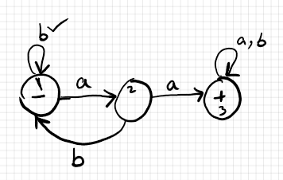
Finite Automata
Solution of Example 3

Slide 12
Relation between RE and FA
Every language that can be accepted by an
FA can be defined by a regular expression
and every language that can be defined by
a regular expression can be accepted by
some FA.

Slide 13
Construct FA from given RE
Construct FA’s from the given RE’s?
r1 = (a+b)*(aa+bb)(a+b)*
r2 = (a+b)(a+b)b(a+b)*

Slide 14
Thanks!
Any question?

